Slide 1
Team P⁵T
Presentation, Proposal, and Paper Program Permissions Tool
Richard Laughlin, James Fitzgerald, Alex Kelley, Jacob Siegel
Sponsor: Nathan Claes
Coach: Tom Reichlmayr
Notes:
James

Slide 2
Agenda
Background
Design
Demo
Future Work
Reflections
Notes:
James

Slide 3

Background
Notes:
James

Slide 4
Background
Replace a manual, email based process with a web system.
  Single point of access
  Automatic aggregation of documents/information.
  Associate information inside the system with information outside.*
Notes:
James

Slide 5
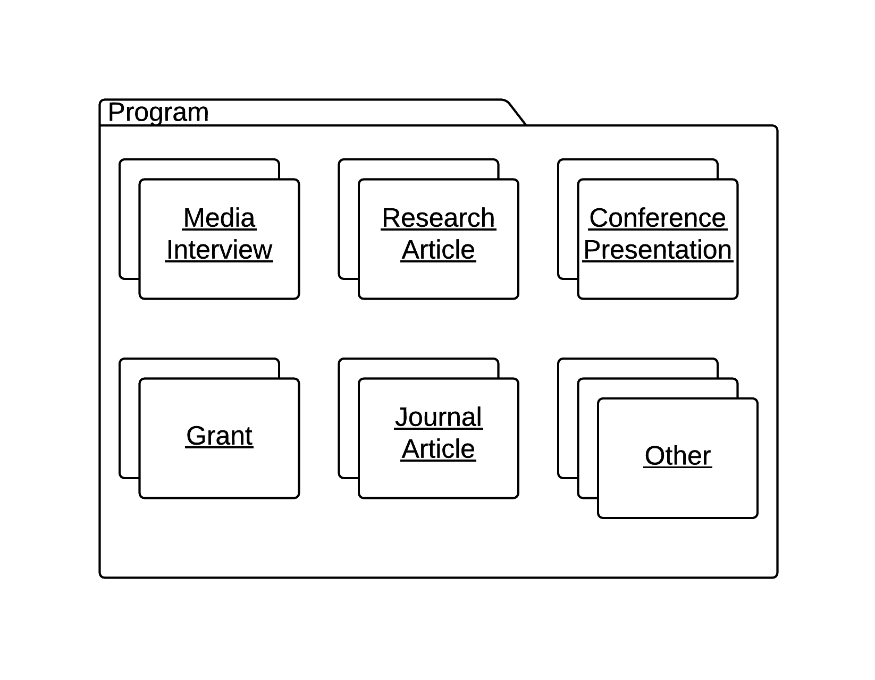
Background
Notes:
James

Slide 6
Design Requirements
Operating System
  Windows
Database
  MSSQL 2008
Platform
  ASP.net / C# MVC 3
Browser
  Internet Explorer 8
Notes:
Rich

Slide 7
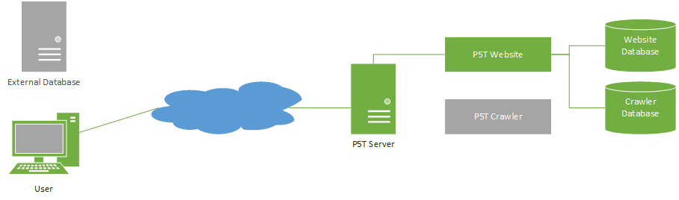
System Design - Web
Notes:
Rich

Slide 8
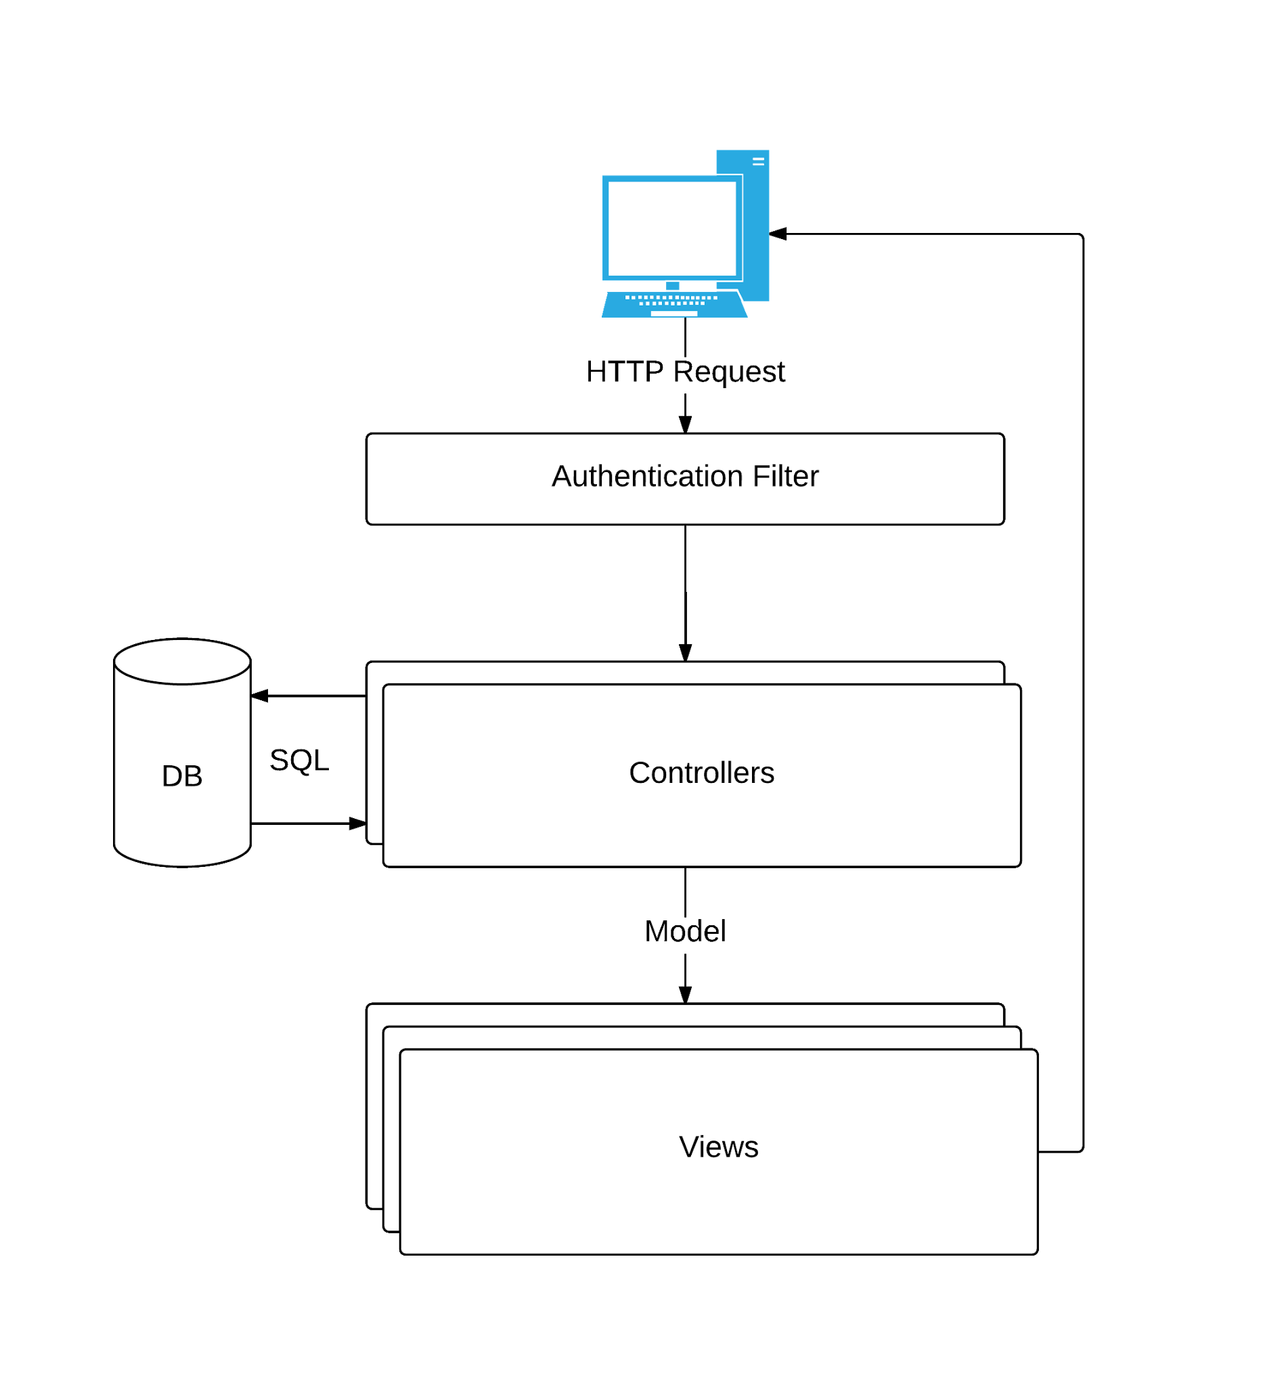
System Design - Web
Notes:
Rich

Slide 9
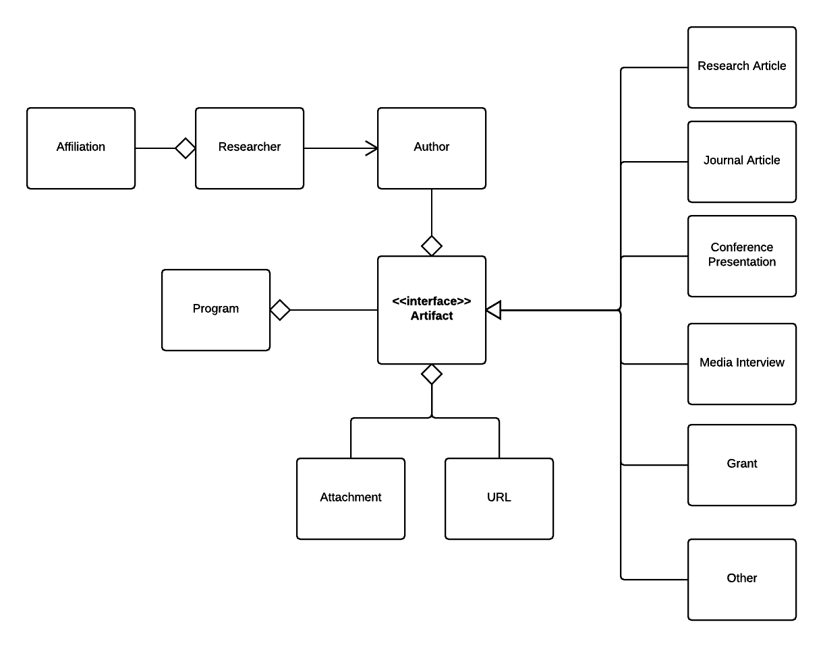
System Design - Web
Notes:
Rich

Slide 10
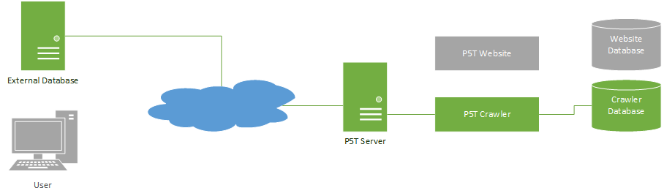
System Design
Notes:
Jacob

Slide 11
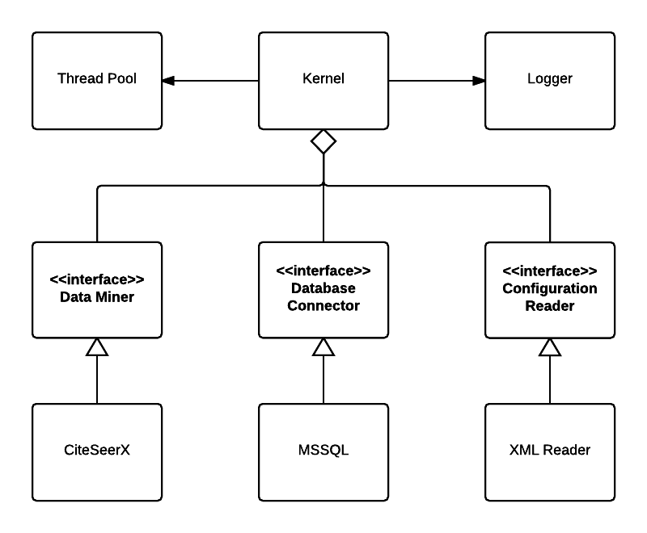
System Design - Crawler
Notes:
Jacob

Slide 12
Demo
Notes:
Rich

Slide 13
Future Work by Us
Final Testing (& Bug Fixes)
Documentation
  Code comments
  A comprehensive user manual
Consistent code formatting
Notes:
Alex
-mention functionality that is done but needs to be integrated(irb status, more robust notifications)

Slide 14
Future Work by Others
Crawler work
  Creation of additional modules
  Attaching the crawler framework to the current website in creative ways.
Notes:
Alex

Slide 15
Reflections
Crawler was appropriately assessed as largest risk throughout project
  Finding sources proved difficult
  Legality of scraping/copyright issues
Documentation and metrics was better handled in the second half
Notes:
Jacob

Slide 16
Reflections
Artificial deadlines led to schedule slide
Could have done more comprehensive testing.
Notes:
Alex

Slide 17
Questions?

